Slide 1
CMPE 220
Class 4 – Assembly Language & Assemblers

Slide 2
RISC versus CISC
Reduced Instruction Set Computer
One clock-cycle per instruction
Effective pipelining
Fewer addressing modes
Requires more instructions per program (more RAM)
Lower gate count
Lower energy use
Complex Instruction Set Computer
Multiple / variable clock-cycles per instruction
More addressing modes
Requires fewer instructions per program (less RAM)
Higher gate count – more chip real estate
Higher energy use

Slide 3
CISC Computers are Often Microprogrammed
Machine instruction set: CISC
Micro-machine instruction set: RISC
From the standpoint of a compiler, and assembler, or a programmer, I would call the a CISC machine

Slide 4
Week 3: What is an Assembler?
An assembler is a program that converts “assembly language” source code into binary instructions (aka machine code or machine instructions)

Slide 5
Machine Code – Common in 1940s
Instruction | Action
0101 1111 1111 0001 | Load the value from the following address into the A register; advance the program counter by 2
0011 1110 1000 0101 | (data address)
0111 1111 1111 0001 | Subtract the following value from the A register; advance the program counter by 2
0000 0000 0000 1100 | (value = 12)
0110 1111 1111 0001 | Store the value from the A register into the following address; advance the program counter by 2
0011 1110 1000 0101 | (data address)
0110 1010 1111 0001 | Compare the following value to the A register; if A is less than or equal to the value, jump to address
0000 0000 0001 0100 | (value = 20)
0100 1000 1000 0110 | (program address)
Notes:
Problems: (1) Really hard and error prone – (2) no idea what this code does! - (3) – tied to machine architecture - (4) Need to remember what each address is used for – (5) Not relocatable – if you want to load things at a different place in memory, addresses change

Slide 6
Assembly Language
Instruction | Action
LDA inventory | Load the value from the specified location into the A register
SBA 12 | Subtract a value (12) from the A register
STA inventory | Store the value from the A register into the specified location
CMPA 20, low_inventory | Compare the A register to a value (20); if A <= 20, go to the address “low_inventory”
• • •
low_inventory:
Notes:
Improvements:
Easier to remember and code, less error prone – (2) Locations identified by name – (3) Identifiers can be mapped to different memory addresses (this is one of the things a loader does Problems: Still tied to machine architecture

Slide 7
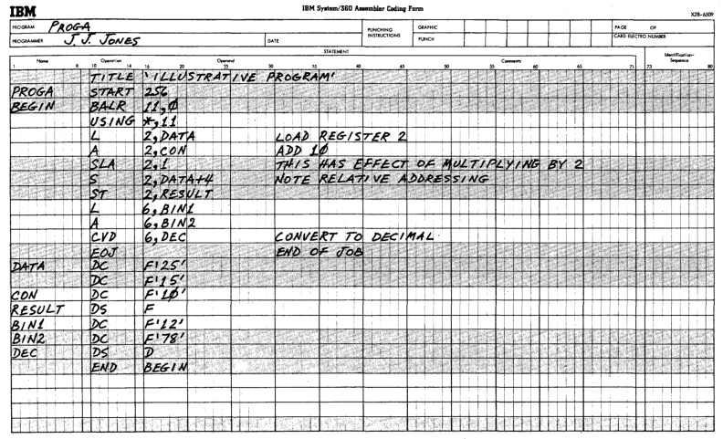
Assembly Language Coding Sheet

Slide 8
Why is it Called an “Assembler?”
Because it “assembles” machine code instructions!
LDA inventory
011001
0101110011
opcode
address

Slide 9
Building Software
High Level Language Source Code (e.g. C++)
Assembly Language Source Code
Binary Machine Code
Compiler
Assembler
optional
Executable
Code
In-Memory
Code
Linker
Loader
Hardware Execution

Slide 10
Wait a Minute!
When you build a program, you don’t go through all those steps! gcc –o program program_source.c ./program
Modern compiler commands “hide” many of the steps… but you still have the option of breaking out the steps, as we saw in the makefile examples: %.o: %.c $(DEPS) $(CC) -c -o $@ $< $(CFLAGS)
To compile a C/C++ to assembly language: gcc -S -o my_asm_output.s helloworld.c

Slide 11
Types of Assemblers (nomenclature)
Assembler: converts assembly language to binary machine code
Macro Assembler: allows the programmer to define new instructions that the assembler “expands” into the actual instruction set This does not create new machine instructions
High Level Assembler: an assembler that includes certain high-level statements – such as IF/THEN/ELSE statements or loops – that don’t correspond direction to machine instructions
Cross Assembler: an assembler that runs on one machine, but generates binary machine code for a different machine
Micro Assembler: converts microassembly source code into microcode… the low level code that implements the machine instruction set

Slide 12
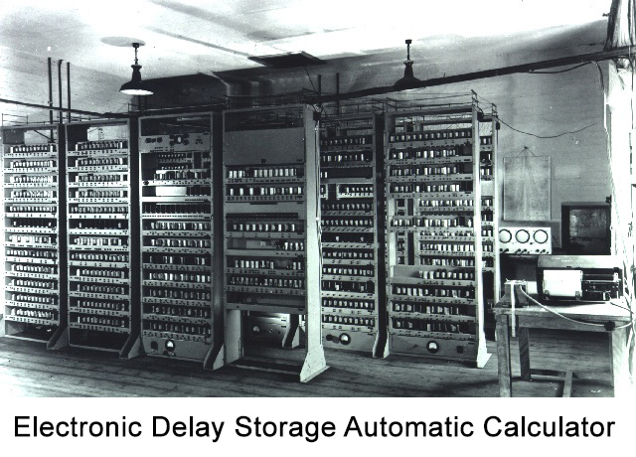
A (small) Bit of History
Kathleen Booth is credited with creating the first assembler in 1947, while working on the ARC2 (Automatic Relay Calculator) computer at the University of London.
David Wheeler independently developed an assembler for the EDSAC (Electronic Delay Storage Automatic Calculator) in 1948.
The IEEE credits Wheeler with creating the first assembler.

Slide 13
Requirements for the first Assemblers
They needed a way to enter mnemonic instructions, so that programmers didn’t need to remember binary opcodes and instruction formats.
They needed a way to associate mnemonic labels with memory addresses.
But: they needed to be very simple! The first assemblers were written in binary machine code, and ran on computers with tiny amounts of memory.

Slide 14
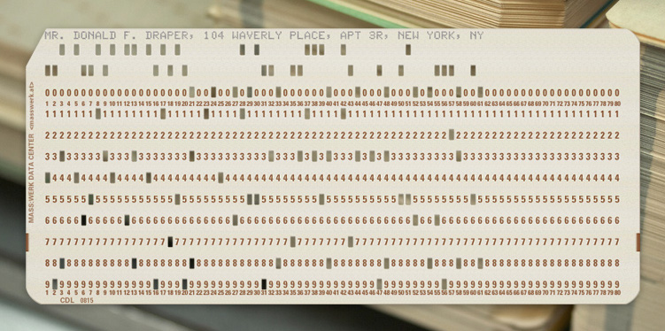
Requirements for an Assembler (continued)
They could use characters to represent assembly language instructions.
Instructions could be entered with punched cards.
Punched cards had been in use since the 1890s.
Businesses were comfortable working with punched cards and keypunches.
Card readers were easily adapted for use with computers

Slide 15
Assembly Language Instruction Formats
The requirements led to a very simply format, that is still in use today. updateinventory LDA inventory
Label (optional)
opcode
Address or register labels (optional)

Slide 16
Non-Instruction Statements (SIC)
So far, we’ve talked about statements that correspond one-to-one to machine code instructions… but there is another statement type required: the memory declaration.
Reserve some memory, and assign a label: inventory RESW 5 (Reserve 5 words) partnumbers RESB 100 (Reserve 100 bytes)
Reserve some memory, and assign a label and starting value: inventory WORD 100 (Reserve 1 word; value=100) partname BYTE C‘widget’ (Reserve 6 bytes; value=‘widget’) Iochannel BYTE X‘05’ (Reserve 1 byte; value=x05)

Slide 17
Other Housekeeping Statements
Indicated starting address of program: programname START 1000
Indicate end of program, and location of first statement: END starthere

Slide 18
What an Assembler Does
Convert mnemonic opcodes to machine language code
Convert symbolic references to memory addresses
Assemble machine code instructions
Write a binary machine code file

Slide 19
Two-Pass Assembler
1st Pass
Identify statements
Determine memory layout
Assign addresses to symbolic references and build “symbol table”
2nd Pass
Assemble instructions
Output binary machine code
Print program listing & address assignments (Symbol Table)

Slide 20
Assembly Example: SIC/XE
Line # | Label | Instruction | Argument | Address | Instruction Size*
1 | Program | START | 1000 | 1000 | 0
2 |  | LDA | Inventory | 1000 | 3
3 |  | LDT | Sales | 1003 | 3
4 |  | SUBR | T, A | 1006 | 2
5 |  | J | Somewhereelse | 1008 | 3
6 | Partnumber | BYTE | C’005740’ | 1011 | 6
7 | Inventory | WORD | 500 | 1017 | 3
8 | Sales | WORD | 27 | 1020 | 3
Note that the SIC/XE has variable length instructions. This is often true of CISC machines. RISC machines have uniform length instructions.

Slide 21
1st Pass: Build Symbol Table
Line # | Label | Instruction | Argument | Address | Instruction Size
1 | Program | START | 1000 | 1000 | 0
2 |  | LDA | Inventory | 1000 | 3
3 |  | LDT | Sales | 1003 | 3
4 |  | SUBR | T, A | 1006 | 2
5 |  | J | Somewhereelse | 1008 | 3
6 | Partnumber | BYTE | C’005740’ | 1011 | 6
7 | Inventory | WORD | 500 | 1017 | 3
8 | Sales | WORD | 27 | 1020 | 3
The Symbol Table contains the addresses of the symbols, not the values stored at those locations.
Symbol | Address
Program | 1000
Partnumber | 1011
Inventory | 1017
Sales | 1020

Slide 22
2nd Pass: Assemble Machine Instructions
Line # | Label | Instruction | Argument | Address | Instruction Size
1 | Program | START | 1000 | 1000 | 0
2 |  | LDA | Inventory | 1000 | 3
3 |  | LDT | Sales | 1003 | 3
4 |  | SUBR | T, A | 1006 | 2
5 |  | J | Somewhereelse | 1008 | 3
6 | Partnumber | BYTE | C’005740’ | 1011 | 6
7 | Inventory | WORD | 500 | 1017 | 3
8 | Sales | WORD | 27 | 1020 | 3
Symbol | Address
Program | 1000
Partnumber | 1011
Inventory | 1017
Sales | 1020
LDA Inventory
011001000000
001111111001
opcode
address

Slide 23
Single Pass Assembler
Uses two tables: a Symbol Table and a Reference Table
When an undefined symbol is encountered, it’s added to the Reference Table
When the symbol is defined, its address is placed in Symbol Table, and all locations that reference the symbol are updated.

Slide 24
Single Pass Example
Line # | Label | Instruction | Argument | Address | Instruction Size
1 | Program | START | 1000 | 1000 | 0
2 |  | LDA | Inventory | 1000 | 3
3 |  | LDT | Sales | 1003 | 3
4 |  | SUBR | T, A | 1006 | 2
5 |  | J | Somewhereelse | 1008 | 3
6 | Partnumber | BYTE | C’005740’ | 1011 | 6
7 | Inventory | WORD | 500 | 1017 | 3
8 | Sales | WORD | 27 | 1020 | 3
Symbol | Reference
Inventory | 1000
Sales | 1003
Somewhereelse | 1008
Symbol | Address
Program | 1000
Partnumber | 1011
Inventory | 1017
Sales | 1020

Slide 25
SIC/XE – Special Hardware Cases
Some Instructions (e.g. LDA) may be 3-byte or 4-byte
24-bit
disp: 12-bit address displacement
32-bit
address: 20-bit address
opcode
flags
disp
opcode
flags
address

Slide 26
2nd Pass Must Update Instructions & Tables
Line # | Label | Instruction | Argument | Address | Instruction Size
1 | Program | START | 1000 | 1000 | 0
2 |  | LDA | Inventory | 1000 | 3
3 |  | LDT | Sales | 1003 | 3
4 |  | SUBR | T, A | 1006 | 2
• • • |  | • • •
6 | Partnumber | BYTE | C’005740’ | 27011 | 6
7 | Inventory | WORD | 500 | 27017 | 3
8 | Sales | WORD | 27 | 27020 | 3
Symbol | Reference
Inventory | 1000
Sales | 1003
Somewhereelse | 1008
Symbol | Address
Program | 1000
Partnumber | 27011
Inventory | 27017
Sales | 27020

Slide 27
2nd Pass Must Update Instructions & Tables
Line # | Label | Instruction | Argument | Address | Instruction Size
1 | Program | START | 1000 | 1000 | 0
2 |  | LDA | Inventory | 1000 | 4
3 |  | LDT | Sales | 1004 | 3
4 |  | SUBR | T, A | 1007 | 2
• • • |  | • • •
6 | Partnumber | BYTE | C’005740’ | 27012 | 6
7 | Inventory | WORD | 500 | 27018 | 3
8 | Sales | WORD | 27 | 27021 | 3
Symbol | Reference
Inventory | 1000
Sales | 1004
Somewhereelse | 1009
Symbol | Address
Program | 1000
Partnumber | 27012
Inventory | 27018
Sales | 27021

Slide 28
2nd Pass Must Update Instructions & Tables
Line # | Label | Instruction | Argument | Address | Instruction Size
1 | Program | START | 1000 | 1000 | 0
2 |  | LDA | Inventory | 1000 | 4
3 |  | LDT | Sales | 1004 | 4
4 |  | SUBR | T, A | 1008 | 2
• • • |  | • • •
6 | Partnumber | BYTE | C’005740’ | 27013 | 6
7 | Inventory | WORD | 500 | 27019 | 3
8 | Sales | WORD | 27 | 27022 | 3
Symbol | Reference
Inventory | 1000
Sales | 1004
Somewhereelse | 1010
Symbol | Address
Program | 1000
Partnumber | 27013
Inventory | 27019
Sales | 27022

Slide 29
Programming an Assembler
Symbol Table: built by 1st Pass; matches symbols to addresses
Reference Table: built be 1st pass; tracks references to symbols
Scanner / Tokenizer: scans each line looking for tokens delimited by space characters: label (optional) – instruction – address or register (optional) – comment?
Instruction lookup: searches a pre-defined table for the matching instruction string. The table contains:
Opcode
Instruction length
Instruction type
Assembly routines: a subroutine to assemble each instruction format.

Slide 30
A Bit More History: The First Assemblers
In the 40s and 50s, memory was very limited. It wasn’t possible to store a two-pass assembler, the source code of the program being “assembled”, and the various data structures in memory. Consequently, computer operators would:
Load the binary object code for the assembler 1st pass from a card reader.
Load the source code of the program being assembled from a card reader.
Load the binary object code for the assembler 2nd pass from a card reader.
Load the source code of the program being assembled from a card reader.

Slide 31
History (continued)
With the advent of magnetic disks in the late 50s, operators didn’t need to load multiple card decks… the two “passes” of the assembler were stored on disk, along with the source code of the program being assembled.
Memory was still very limited, and the same sequence of “overlay” steps was still performed… although much faster!

Slide 32
Assembler Output: the Object File
Not just a binary executable file!
Specifics vary from system to system.
Common elements:
Header record:
Start address
Length
Reference Table (for linking object files)
Symbol Table (for linking object files)

Slide 33
Assembler Output: the Listing
Line numbers and source code (including comments)
Binary (octal, hex) instruct codes
Symbol Table
Error messages!

Slide 34
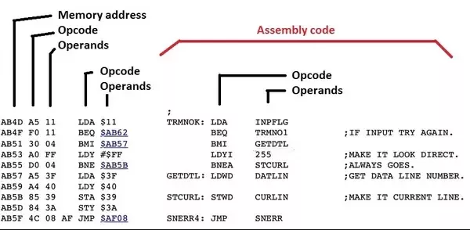
Assembler Output: Sample Listing

Slide 35
Assembler Error Conditions
Unrecognized Opcode: LDQ
Missing address: LDA
Missing register(s): ADDR ADDR S
Invalid register(s): ADDR S, G

Slide 36
Assembler Error Conditions (continued)
Unknown Address: location referenced but not defined: LDA inventroy
Duplicate label definition: inventory WORD 500 • • • inventory WORD 500
Location defined but never referenced (warning): inventofy WORD 500

Slide 37
What is Pseudocode?
An informal high-level description of an algorithm
Typically includes programming language constructs such as IF/THEN/ELSE, DO/WHILE, FOR, etc.
Typically includes use of variables
Augmented by natural language (Descriptions)
May be more or less “formal”
May resemble a particular programming language

Slide 38
Pseudocode: Scan a Line
label opcode argument ;comment
Get next line from input file
$current-char = first character
IF ($current-char is not a space) THEN
Copy characters until blank or end-of-line into $label;
Skip blanks
IF ($current-char == end-of-line) THEN
GOTO error
Copy characters until blank or end-of-line into $opcode
Skip blanks
IF (($current-char != end-of-line) and ($current-char != ‘;’)) THEN
Copy characters until blank or end-of-line into $argument
Skip blanks
IF ($current-char != end-of-line) THEN
Copy characters until end-of-line into $comment

Slide 39
Pseudocode: Scan a Line (cont)
Get next line from input file
IF (first character is not a space) THEN
Copy characters until blank into $label;
Skip blanks
IF (end-of-line) THEN
GOTO error
Copy characters until blank into $opcode
Skip blanks
IF (not end-of-line) THEN
Copy characters until blank into $argument

